Slide 1
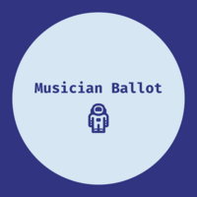
Musician Ballot
#Music-On-The-BlockChain

Slide 2
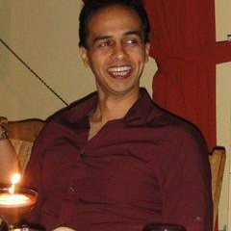
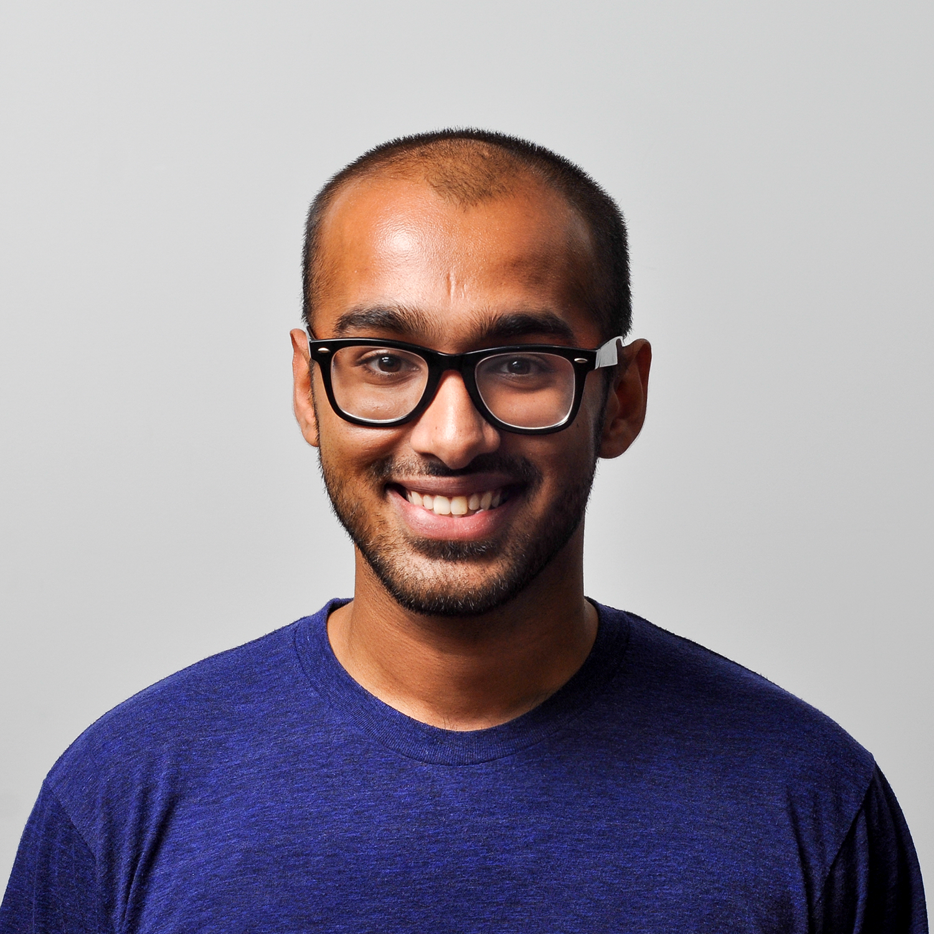
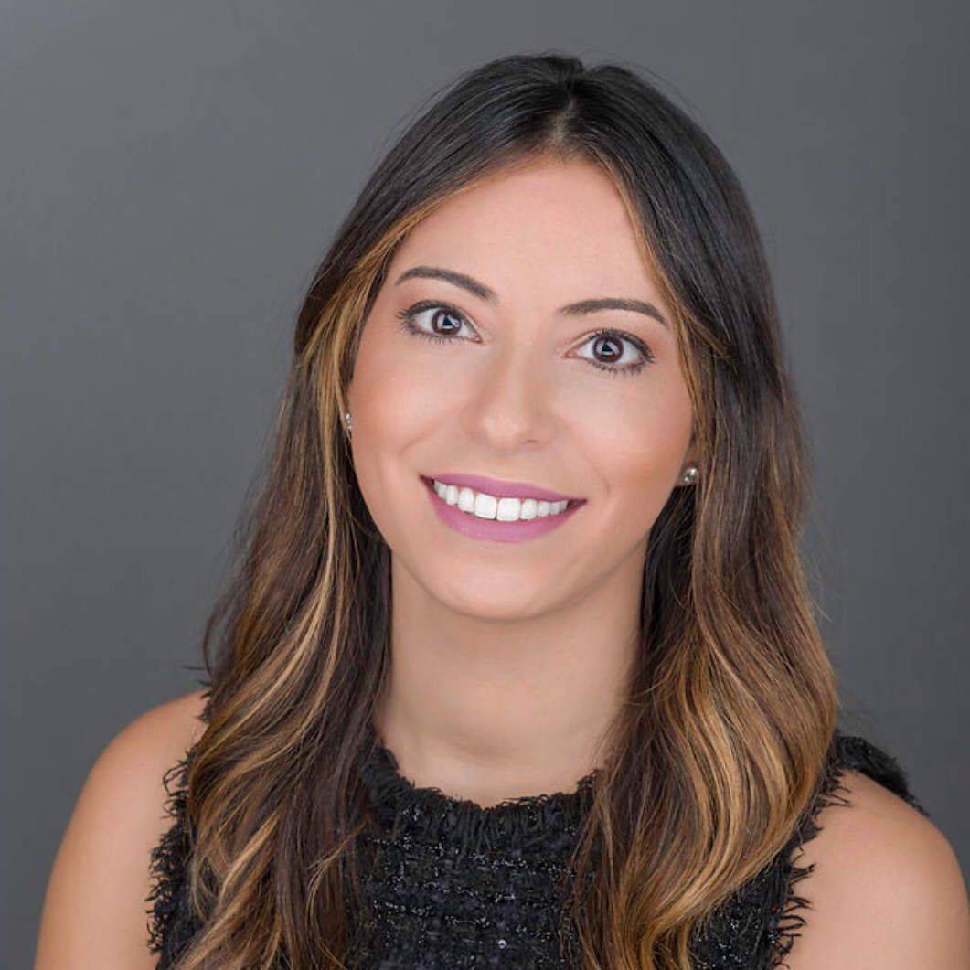
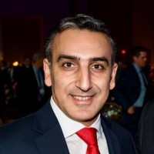
The Team
Roland Ferrao
Armen Arsenyan
Jennifer Rionda
Engineer with experience in building AI applications and newly expanded skill-set in blockchain
Advanced architect of smart contracts built on blockchain applications
Professional storyteller, amateur user experience designer and blockchain engineer

Slide 3
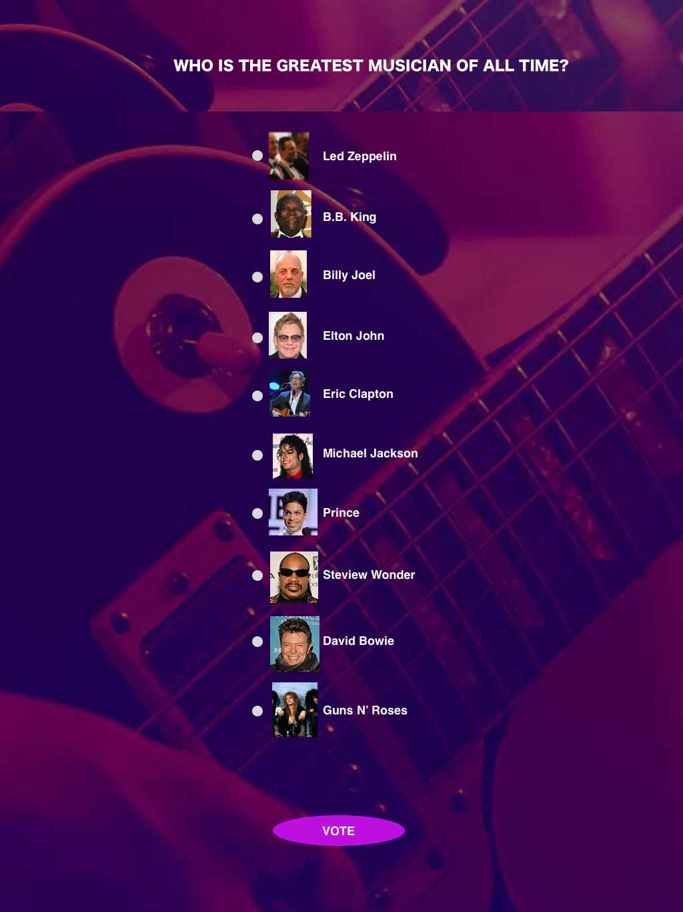
The Music Ballot (MB) App
Is a decentralized application built on the Rinkeby testnet that allows users to vote on their favorite musician from a predefined list

Slide 4
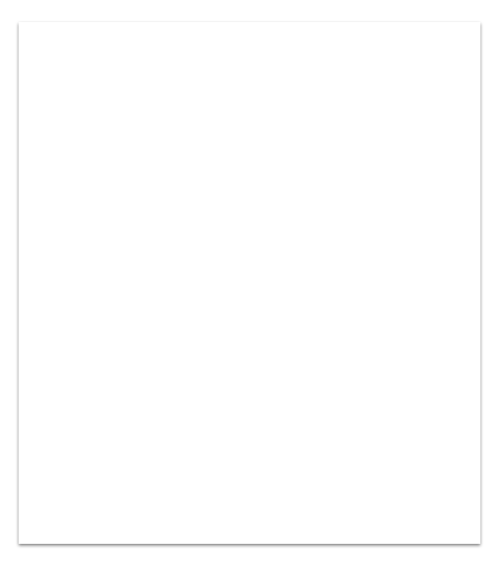
The voting transaction
Is registered on the blockchain using the Rinkeby testnet and MetaMask wallet
JavaScript/CSS/HTML/web3.js (UI)
MetaMask (Wallet)
Truffle (Dev Environment)
Solidity (Contract Language)
Rinkeby (Network)
Netlify (Hosting)

Slide 5
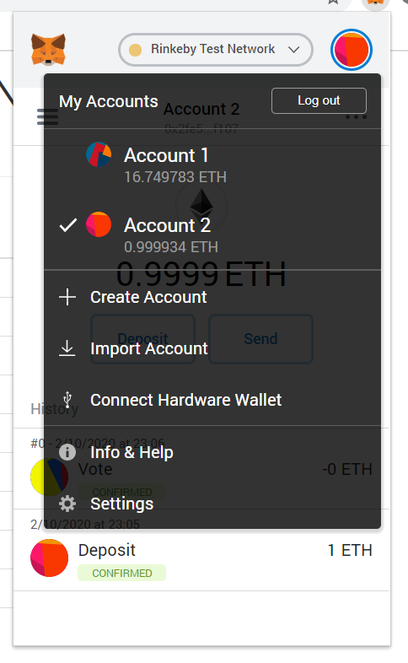
How to use the app
Create an account in MetaMask on the Rinkeby network
Obtain ether on the Rinkeby network via the test faucet using a social network account OR phone a friend
Access the Musician Ballot app
Review the pre-selected list of best Musicians of all time and cast your vote
Confirm your vote was captured

Slide 6
Key benefits
Secure method to capture votes with broad application (e.g., electoral voting).
No duplication or deletion of votes for a unique address
Connected to a simple and intuitive user interface

Slide 7
Challenges
Learning curve for the Truffle suite, which allows you to develop locally, over Remix which is in browser compiling and deploying
Resources engineered their solution on Solidity 0.4 so team needed to re-engineer based on class resources

Slide 8
Now let’s test the app!
Open Metamask
Switch to the Rinkeby Network
Confirm you have received Ether from the team
Make sure you are using a new address if already voted
Click on link: https://musicians-ballot-app.netlify.com/
Vote on your favorite musician

